Slide 1
Non-Tuberculous Mycobacterial Lung Disease
Preliminary analyses

Slide 2
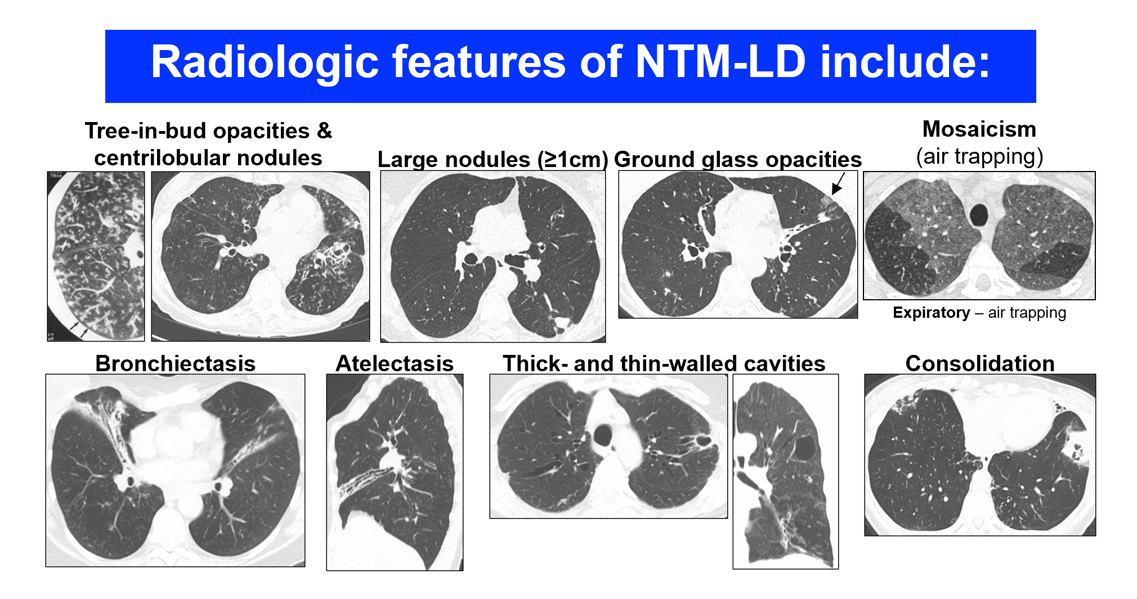
Overview of Disease
Caused by organisms belonging to Mycobacterium avium complex
Disease associated with radiologic features
Indications that right middle lobe (RML), lingula, and right upper lobe (RUL) are more severely affected
Source: Choi, Sangbong, et al.

Slide 3
Objectives and Approach
Research Questions:
Are there differences in the frequencies and severities for each of the specific CT features among the lung lobes in NTM-LD?
Are there differences in (1) between MAC-LD and M. abscessus-LD?
Approach:
Based on previous analyses performed by Matthew J. Strand, PhD
Rater included as variable for our analysis
Comparing models fit through R and SAS

Slide 4
Radiologic Features’ Scoring
Features with Ordinal Score
Tree-in-bud
Ground glass opacities
Consolidation
Bronchiectasis
Atelectasis
Scoring:
0: None
1: <25% involvement of the lobe
2: 25-50% involvement of the lobe
3: >50% involvement of the lobe
Features with Binary Score
Large nodules
Thin wall cavities
Thick wall cavities
Scoring:
0: Absent
1: Present

Slide 5
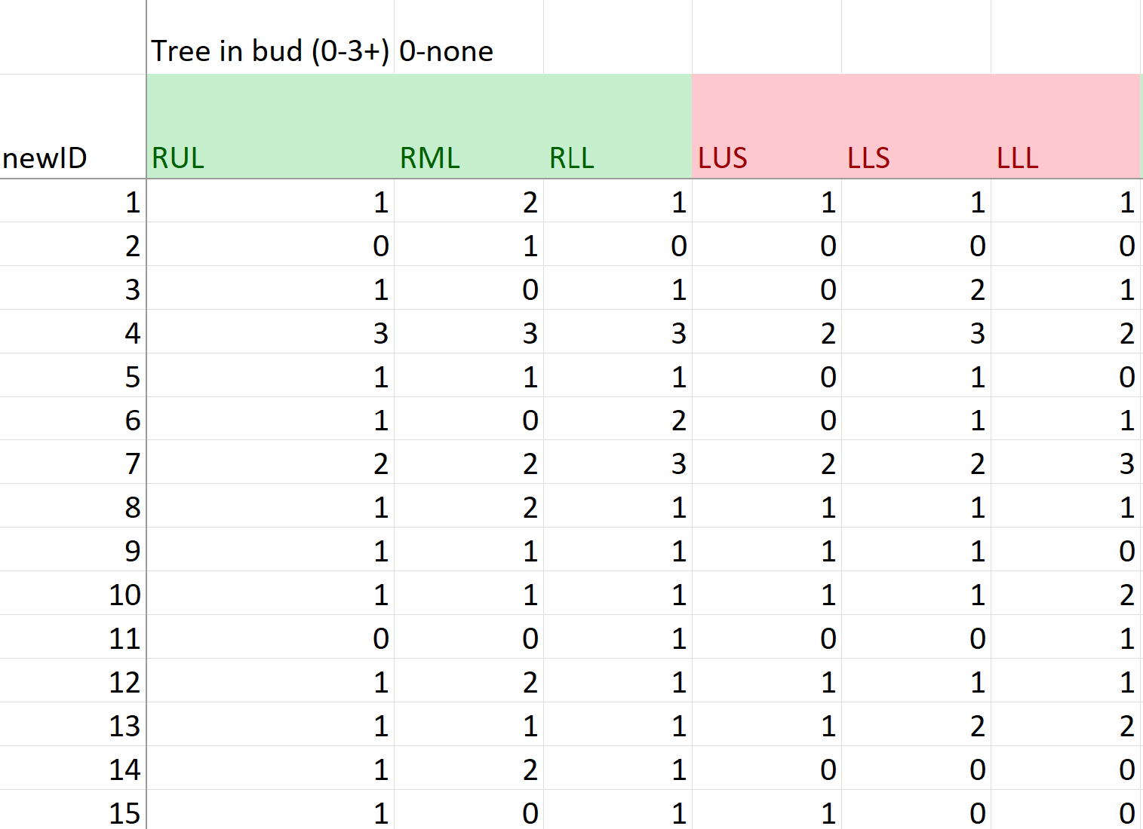
Data Structure and Cleaning
161 subjects: 6 lobes scored with 2 raters scoring for each subject
Variables in preliminary analysis: subject ID, lobe, score of given lobe, rater
Data provided in an excel document, each rater as a separate sheet of scores
Data Cleaning
Minimal, mostly converting to long format
Put each feature in its own sheet for ease of modeling

Slide 6
Preliminary Modeling Approaches
SAS
R
Ordinal Outcome
PROC GLIMMIX with cumulative logit link, lobe as fixed effect, random intercepts, and rater as fixed and random effect
Binary Outcome
PROC GLIMMIX with logit link, lobe as fixed effect, random intercepts, and rater as fixed and random effect
Model only converged for thin wall cavity feature, large nodules converged with rater as random effect but not fixed effect, thick wall cavity converged with rater as fixed effect but not random effect*
Ordinal Outcome
Fixed effects models in polr() from the MASS package with lobe and rater as fixed effects
Allows the use of brant() function to assess PO assumption
Mixed effects models in clmm() from the ordinal package with lobe and rater as fixed effects and random intercepts
Function did not allow rater as random effect (only 2 levels)*
Binary Outcome
Mixed effects models in glmer() from lme4 package with logit link, lobe and rater as fixed effects, and random intercepts
Was also able to successfully model rater as random effect for large nodule and thin wall cavity features, not thick wall cavity*
*Please see “Next Steps” slide where we address these

Slide 7
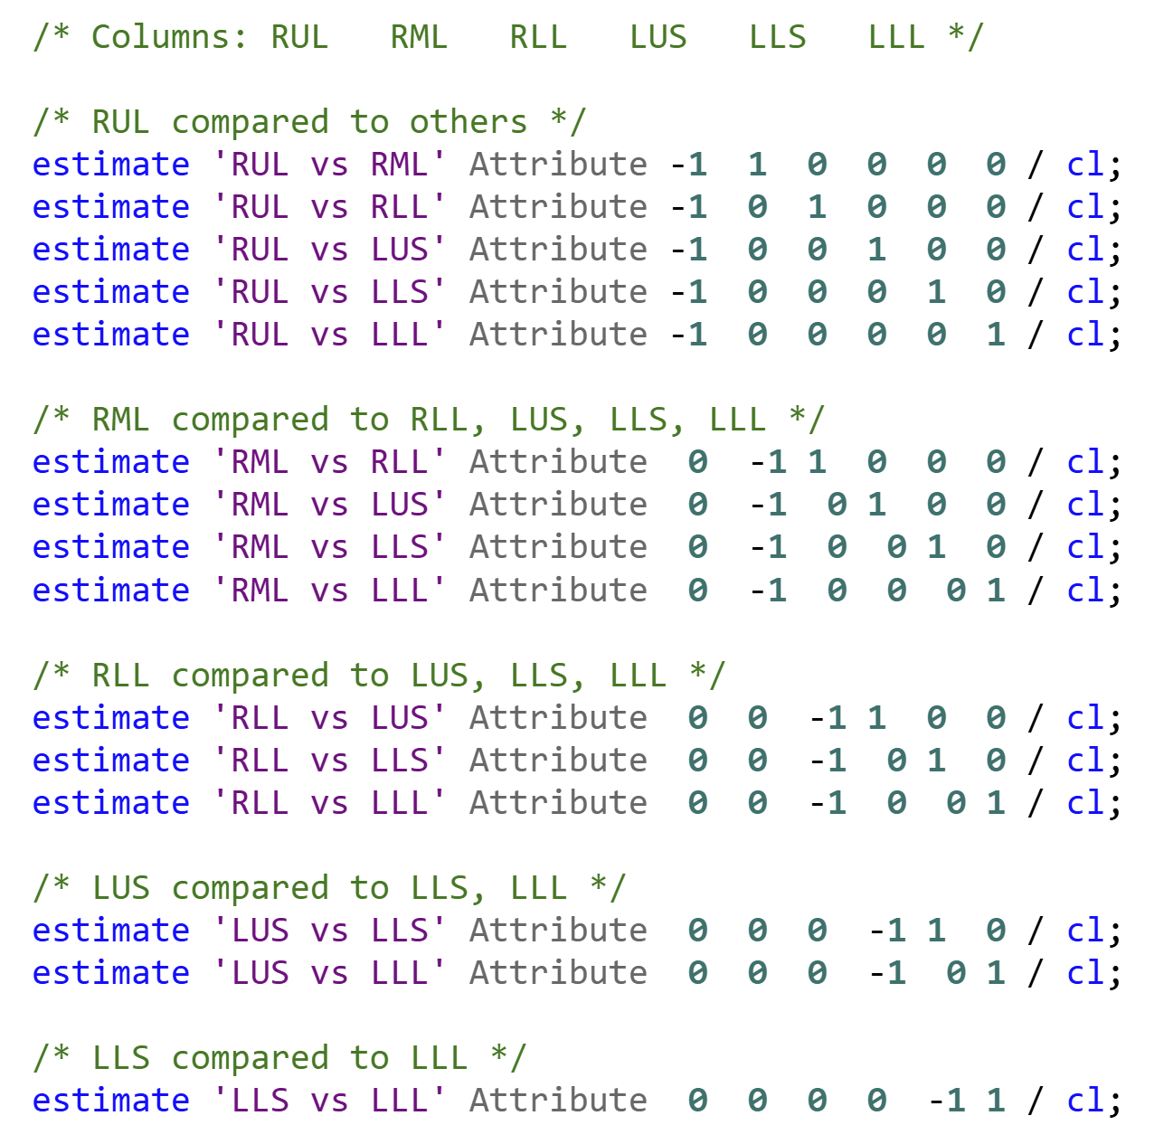
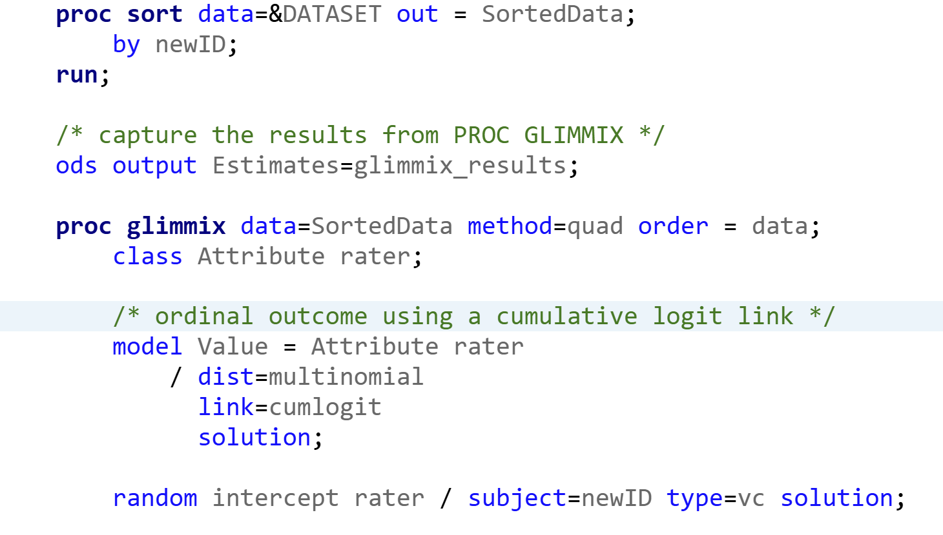
Example Ordinal Model

Slide 8
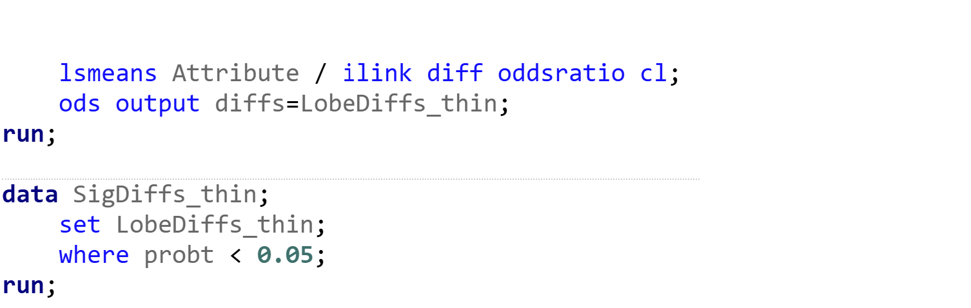
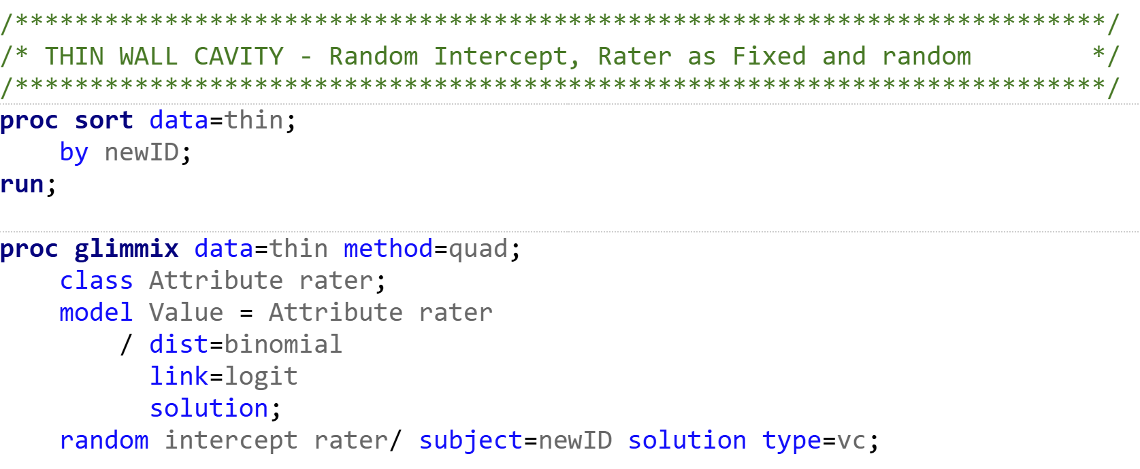
Example Binary Model

Slide 9
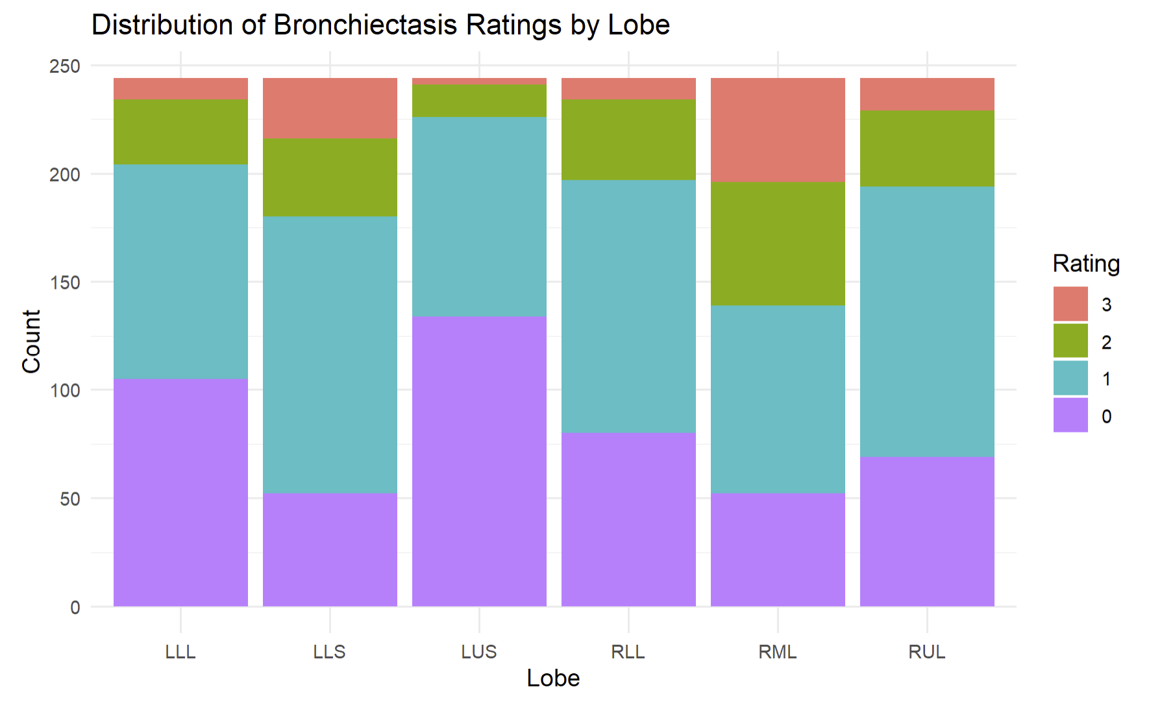
Some features with significant differences in severity between lobes
Bronchiectasis
RML and LLS had greater severity of bronchiectasis
RML had significantly higher grade vs. all other lobes, p < 0.05
LLS had significantly higher grade vs. RUL, RLL, LUS, and LLL, p < 0.05
Results from R models similar

Slide 10
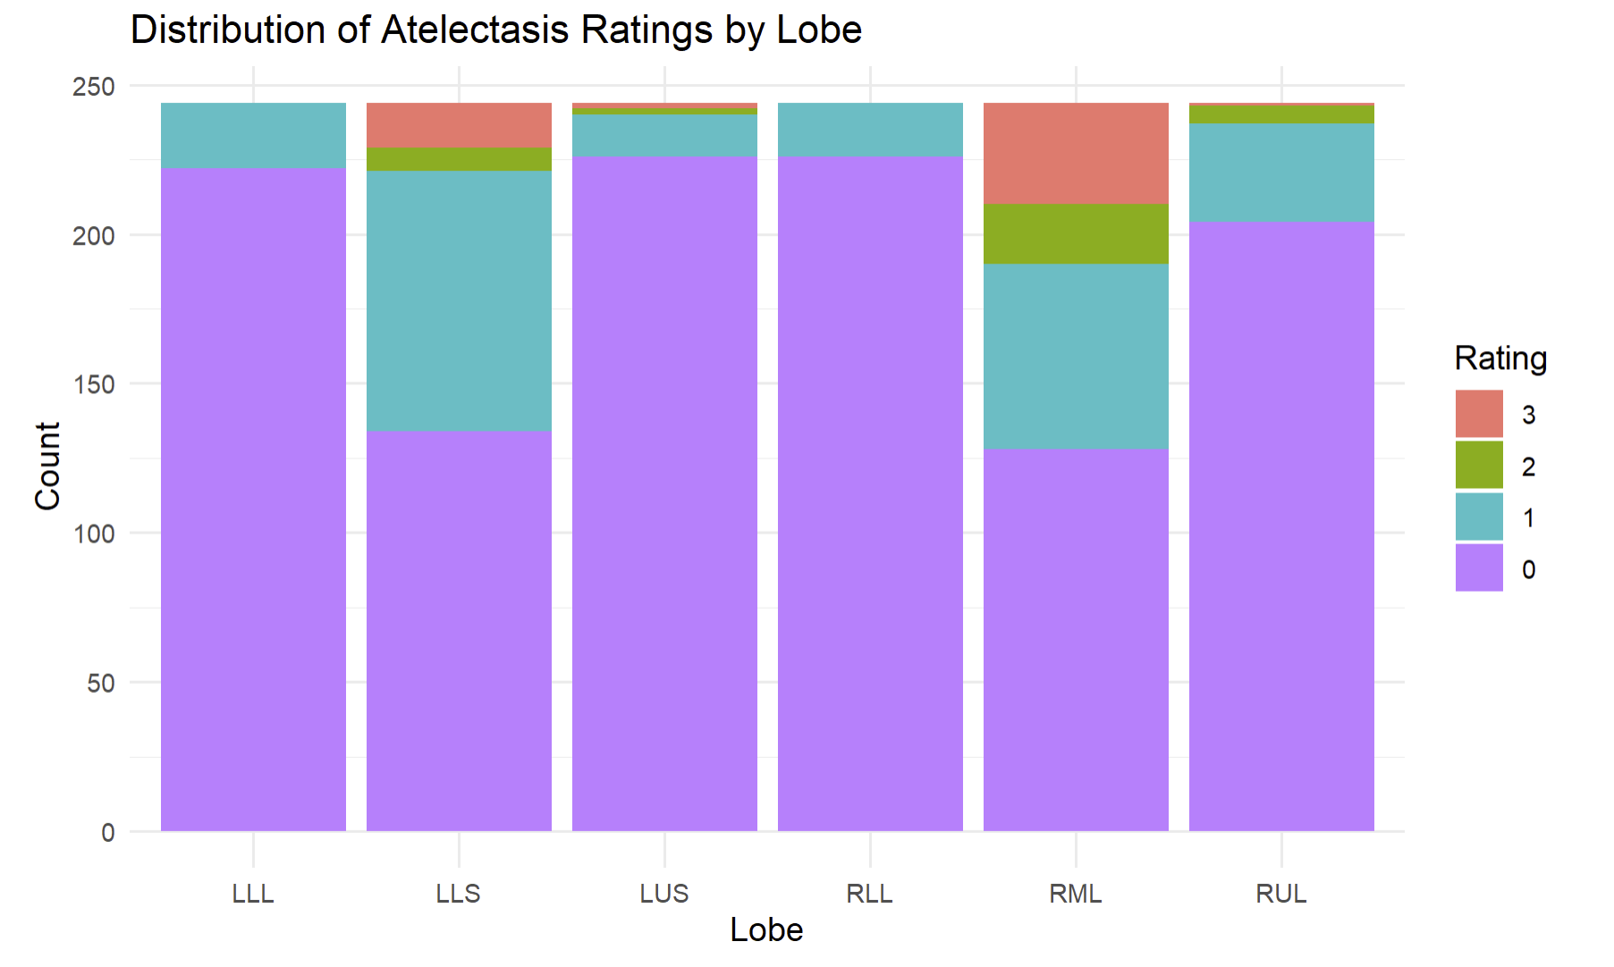
Some features with significant differences in severity between lobes
Atelectasis
RML and LLS had greater severity of atelectasis
RML had significantly higher grade vs. all other lobes, p < 0.05
LLS had significantly higher grade vs. RUL, RLL, LUS, and LLL, p < 0.05
Results from R models similar, but RML-LLS comparison not significantly different

Slide 11
Next Steps
Think of ways to address models that didn’t converge
Fitting models to final data
Incorporating the subjects’ MAC species into analysis to address research question 2
Calculating ICC to determine raters’ consistency
Trying different correlation structures

Slide 12
Sources
Choi, Sangbong, et al. “Can physics principles help explain why non-tuberculous mycobacterial lung disease is more severe in the right middle lobe and lingula?” Journal of Thoracic Disease, vol. 11, no. 11, Nov. 2019, pp. 4847–4854, https://doi.org/10.21037/jtd.2019.10.70.

